Slide 1
Yelp
Low-Fi Mockup
Group: NaCl
Kanyarak Anuchitlertchon
Linette Maliakal
Uljana Sejko
Janeen Soria
Notes:
Our business page low-fi mockup focuses on what non-registered visitors see and interact with

Slide 2
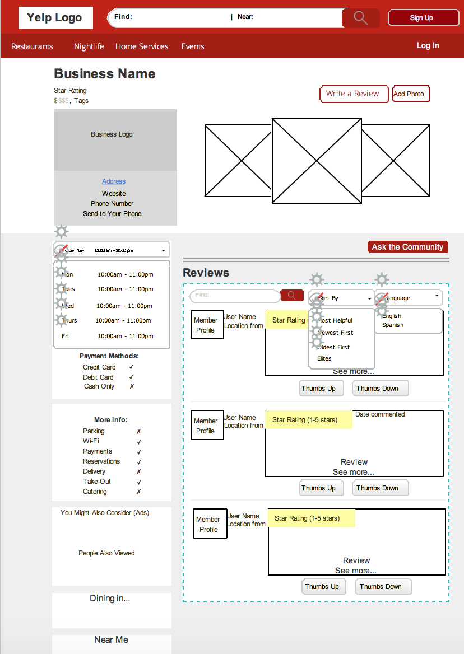
Layout
Switched the background colors
white would give more emphasis to the information at the top of business page
majority gray background is less straining for users’ eyes
white squares in gray background pops up more than gray squares in white background
Notes:
Janeen

Slide 3
Layout
F
“F” shape
moved reviews to right side and other features to the left
easier for users to quickly look at features
“Locking” sections
side features are locked into place while reviews can be scrolled, prevents feeling of too much empty space
top menu “follows” user as they scroll down
Notes:
Janeen

Slide 4
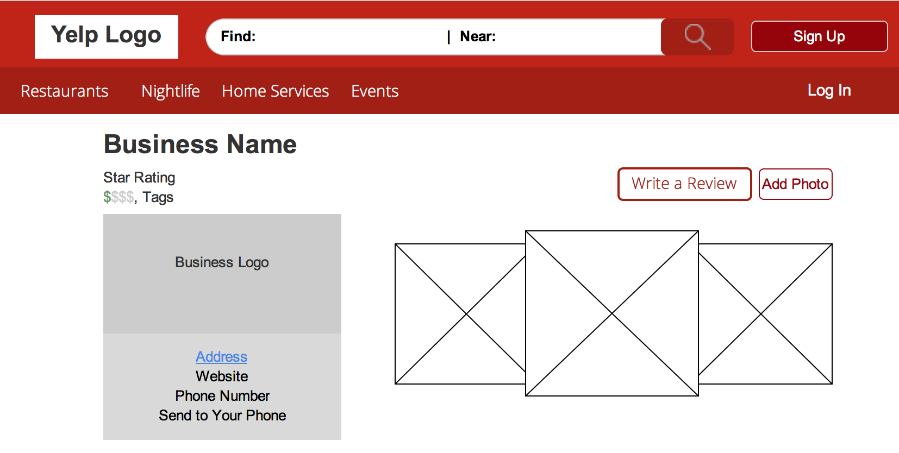
Business Profile
Replace map w/ specific business logo
Address → hyperlink
Notes:
Replacing map w/ specific business logo (original map when clicked on opened up map image through Yelp, unnecessary b/c can look at map view through Google Maps
Also b/c was very repetitive originally with how many ways there were to get to image of Yelp map
Link to Address would bring you to Google Maps

Slide 5
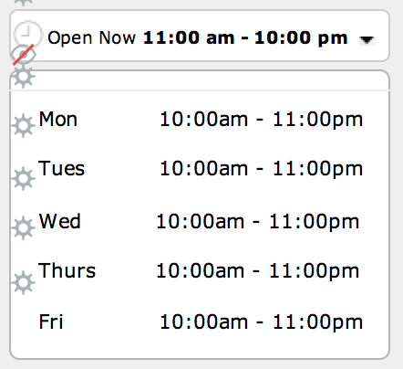
Business Hours
Show current status
Expand/Compress list
Notes:
ULI

Slide 6
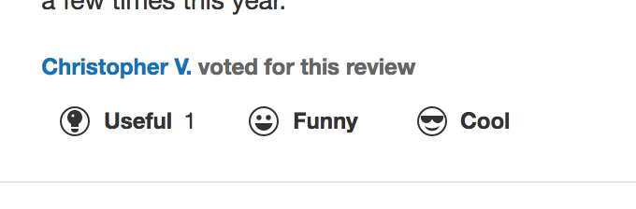
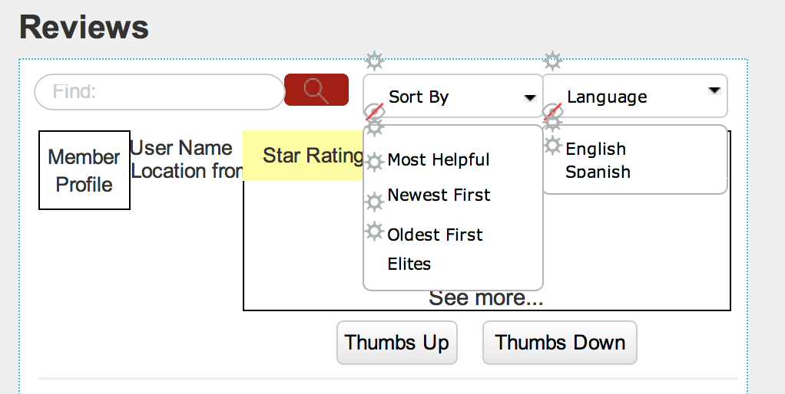
Sorting of Reviews
Replace reaction icons with “thumbs up” and “thumbs down” icons
to organize Reviews by Most Helpful first
Get rid of “Yelp Sort” → replace w/ “Most Helpful”
Notes:
Most Helpful based on how many “Thumbs Up” it receives
“Thumbs Up” and “Thumbs Down” will be a feature non-registered visitors can use
“Thumbs Up/Down” will use physical hand icons, not words! lol

Slide 7
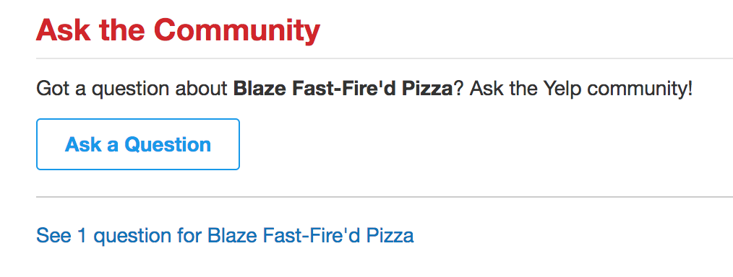
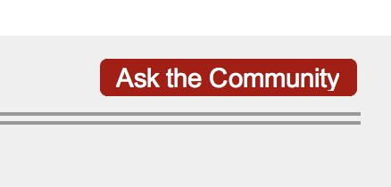
Questions From Users
Notes:
Make it a smaller button, less attention drawn to it, no need for all the description of what it’s for
When button clicked on, will bring up Bubble like page on the business page itself, blacks out background (WON’T open completely new window)
Only registered members in the end are able to ask community questions, not a feature un-registered Yelp visitors are drawn to/would want to use

Slide 8
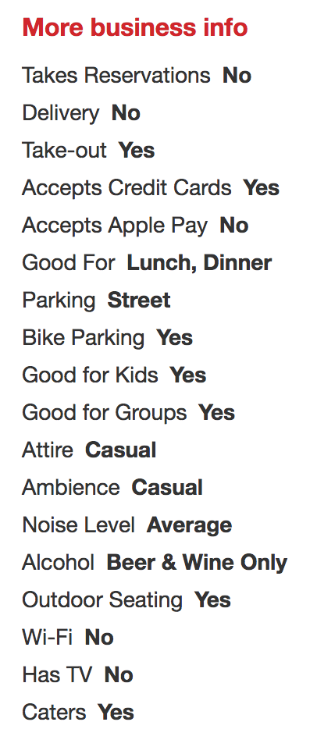
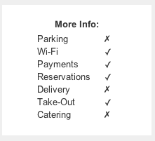
More Info
Use basic symbols:
Checkmark (✓)
X mark (✗)
Business can always add more/provide more info to Yelp
Notes:
Mention how for business info, we are including standard ones on mockup BUT explain how if business wants users to see more info about them on Yelp, business would directly provide Yelp with that information

Slide 9
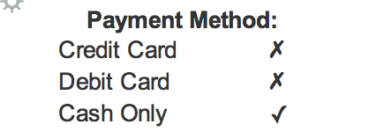
Payment Method
Notes:
Apple pay Android pay
Made it into it’s own section

